Slide 1
AANet: Adaptive Aggregation Network for Efficient Stereo Matching
Group 11
組員：邱恆毅、王軒、曾致崴
June 6, 2023

Slide 2
Outline
Introduction
Methodology
Experiments
Conclusion
Project Proposal

Slide 3
Introduction

Slide 4
Introduction
Title : AANet: Adaptive Aggregation Network for Efficient Stereo Matching
Conference : CVPR 2020
Publish Date : 13-19 June 2020
Citation : 174
Notes:
Frame interpolation is a kind of video processing method.
By using two image to gain frame between them.
Commonly, use generative model to predict frmaes.
It can include more contexual msg. But SLOW

Slide 5
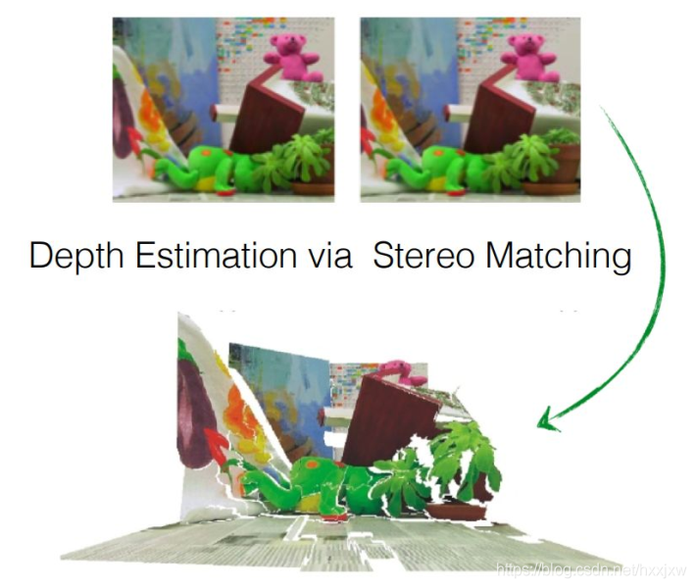
Introduction
Task : stereo matching
Extract depth information from a pair of stereo images
Matching corresponding points or features in the left and right images to estimate the disparity or the distance between the camera and the objects in the scene.
picture ref : https://blog.csdn.net/hxxjxw/article/details/108861946
Notes:
Frame interpolation is a kind of video processing method.
By using two image to gain frame between them.
Commonly, use generative model to predict frmaes.
It can include more contexual msg. But SLOW

Slide 6
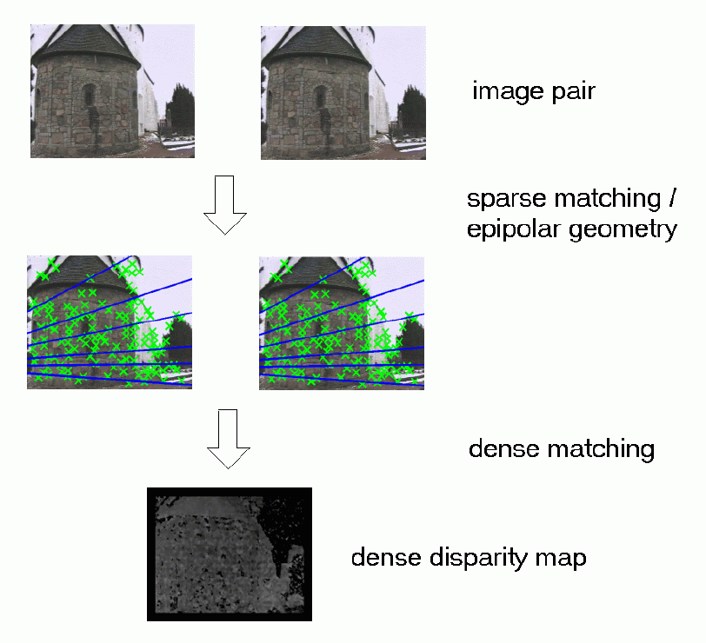
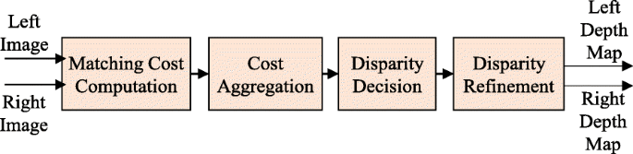
Introduction
Stereo matching Task
Matching cost computation
Cost aggregation
Disparity computation
Disparity refinement
https://homepages.inf.ed.ac.uk/rbf/CAMERA/RESULTS/YEAR3/node8.html
https://jivp-eurasipjournals.springeropen.com/articles/10.1186/s13640-020-00525-3
Notes:
Frame interpolation is a kind of video processing method.
By using two image to gain frame between them.
Commonly, use generative model to predict frmaes.
It can include more contexual msg. But SLOW

Slide 7
Introduction
Traditional stereo matching algorithms
Global methods - solved optimization problem by
Minimize global objective function (data, smoothness terms)
Local methods - faster, only consider neighbor information
Traditional stereo matching algorithms Challenge
Textureless region
Repetitive patterns
Thin structures
Notes:
Frame interpolation is a kind of video processing method.
By using two image to gain frame between them.
Commonly, use generative model to predict frmaes.
It can include more contexual msg. But SLOW

Slide 8
Introduction
Learning based stereo matching
DispNetC (2016 ICCV workshop):
First end-to-end trainable framework
Correlation layer - measure similarity of left and right image features
GC-Net (2017 ICCV):
Concatenate left and right features -> get high dimension feature
Use 3D convolution to aggregate 4D cost volume
PSMNet (2018 CVPR):
Improves GC-Net by 3D convolutions for cost aggregation
Notes:
Frame interpolation is a kind of video processing method.
By using two image to gain frame between them.
Commonly, use generative model to predict frmaes.
It can include more contexual msg. But SLOW

Slide 9
Introduction
Learning based stereo matching
GA-Net (2019 CVPR):
Notices the drawbacks of 3D convolutions
Replace 3D convolution with two guided aggregation layers.
Still use 15 3D convolution layers
Contribution:
State-of-the-art results without any 3D convolutions -> speed up inference time
Proposed ISA, CSA module
Notes:
Frame interpolation is a kind of video processing method.
By using two image to gain frame between them.
Commonly, use generative model to predict frmaes.
It can include more contexual msg. But SLOW

Slide 10
Methodology

Slide 11
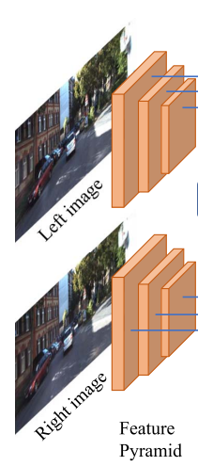
Feature Extraction
Given rectified image pair
Extract feature pyramid with shared ResNet-like architecture
1/3, 1/6, 1/12 original resolution

Slide 12
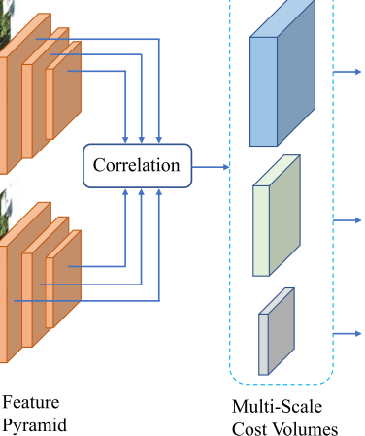
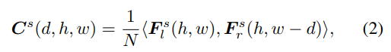
Cost Volume
Calculate correlationwith inner product of feature vectors
Search window Dmax
Form a 3D cost volume of demension h*w*Dmax

Slide 13
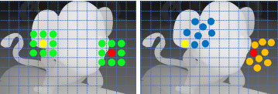
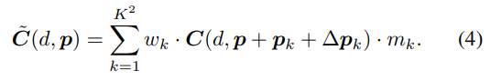
Adaptive Intra-Scale Aggregation(ISA)
Faster then traditional 3D convolution
Aggregates costs for a certain scale
Content-adaptive deformable convolution
Alleviates the well-known edge-fattening issue

Slide 14
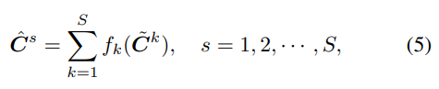
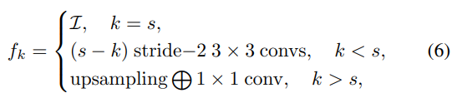
Adaptive Cross-Scale Aggregation(CSA)
Combine features from different scales
Improvement in low-texture or textureless regions

Slide 15
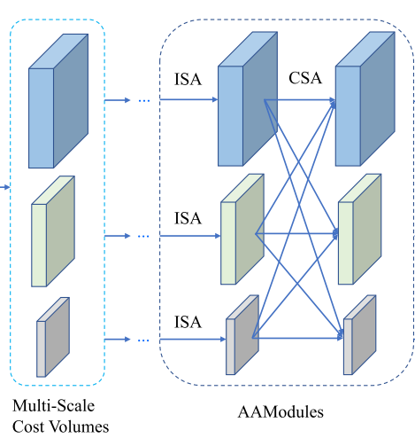
Cost Aggregation
Combining ISA and CSA to form an Adaptive Aggregation Module(AAModule).
We can stack AAModules multiple times.

Slide 16
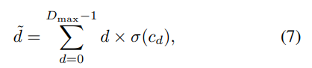
Disparity Regression
For each pixel, adopt the soft argmin mechanism to obtain the disparity prediction.
Notes:
argmin not differentiable

Slide 17
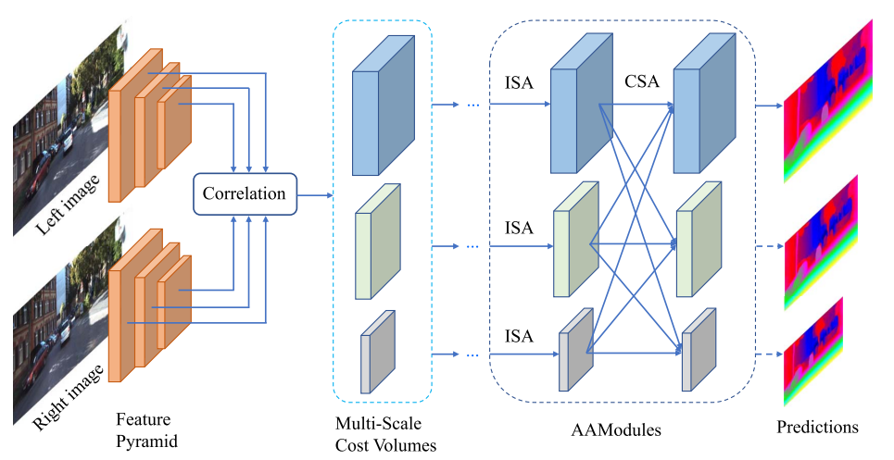
Full Architecture

Slide 18
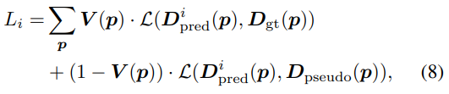
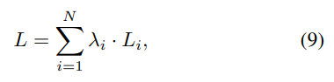
Loss Function
Use smooth L1 loss as loss function. For KITTI dataset, use pretrained GA-Net for where ground truth is not available.

Slide 19
Experiment

Slide 20
Dataset
Scene Flow
Synthetic dataset
Dense ground truth disparity maps
KITTI 2012, KITTI 2015
Real-world dataset
Sparse ground truth disparity maps

Slide 21
Ablation Study
EPE(End Point Error): Mean disparity error in pixels
> 1px(1-pixel error): Average percentage of pixels whose disparity error > 1 pixel
D1-all: Average percentage of pixels whose predictions are wrong in first frames

Slide 22
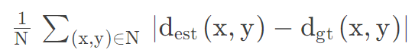
Ablation Study
EPE(End Point Error):
> 1px(1-pixel error):
https://blog.csdn.net/weixin_40957452/article/details/124489843

Slide 23
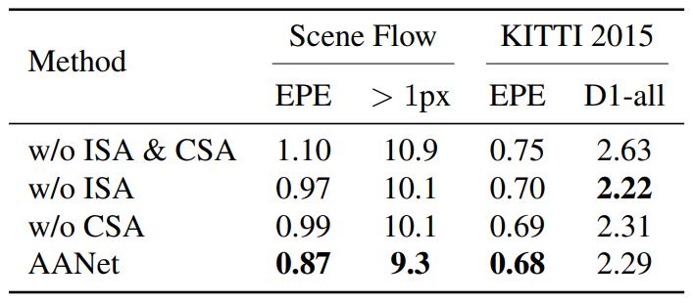
Ablation Study

Slide 24
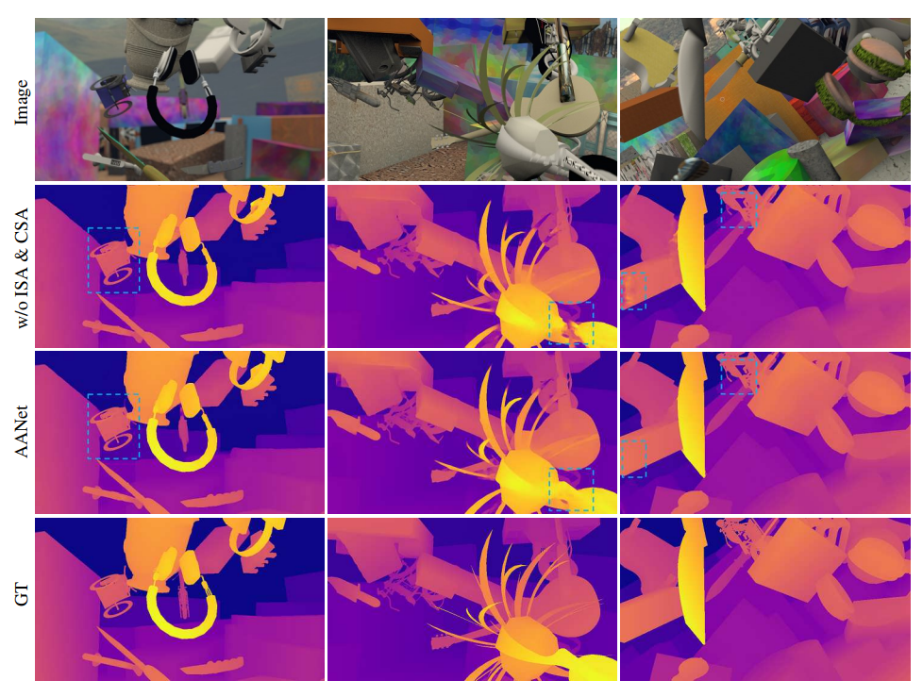
Ablation Study

Slide 25
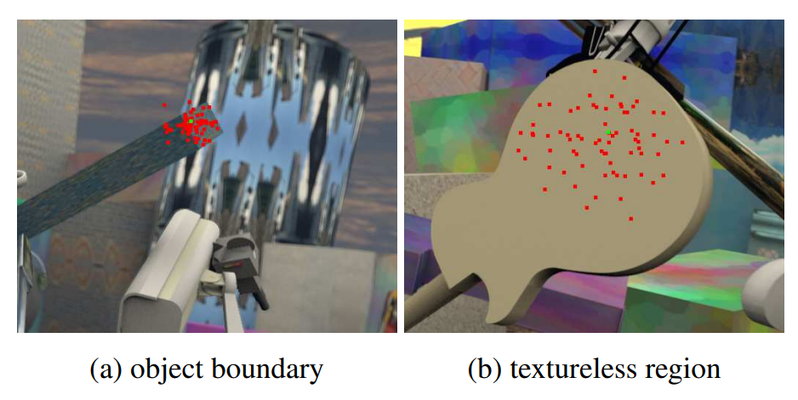
Sampling Points

Slide 26
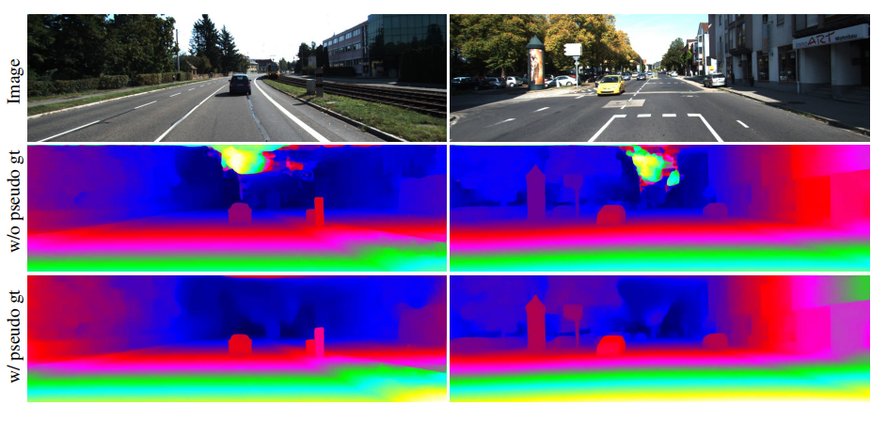
Pseudo Ground Truth Supervision

Slide 27
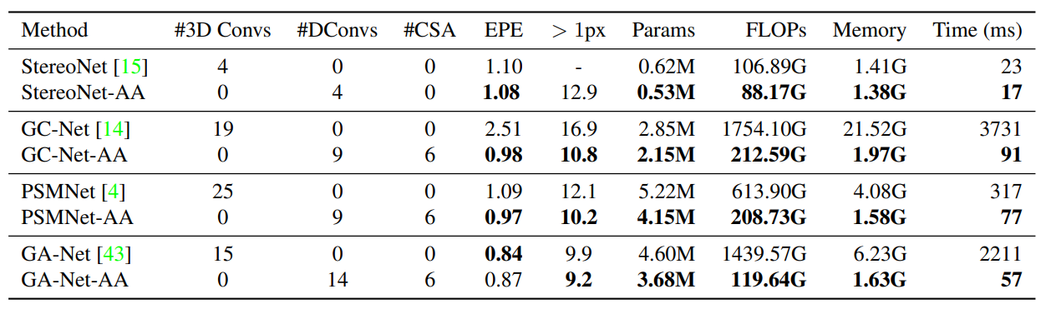
Comparison with 3D Convolutions
Dataset: Scene Flow
DConvs: Deformable convolution

Slide 28
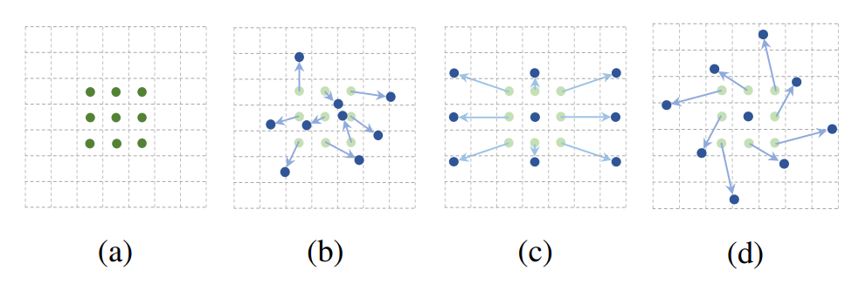
Deformable Convolution
Dai, J., Qi, H., Xiong, Y., Li, Y., Zhang, G., Hu, H., & Wei, Y. (2017). Deformable convolutional networks. In Proceedings of the IEEE international conference on computer vision (pp. 764-773).

Slide 29
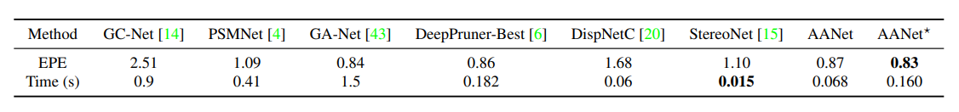
Results on Scene Flow

Slide 30
Results on KITTI 2012 and KITTI 2015
Average percentage of pixels whose predictions are wrong
Out-Noc: in non-occluded regions
Out-All: in all regions
D1-bg: in background regions in first frames
D1-all: in all regions in first frames

Slide 31
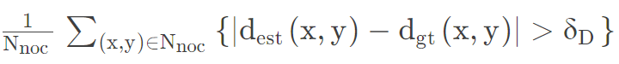
Results on KITTI 2012 and KITTI 2015
Out-noc:
https://blog.csdn.net/weixin_40957452/article/details/124489843

Slide 32
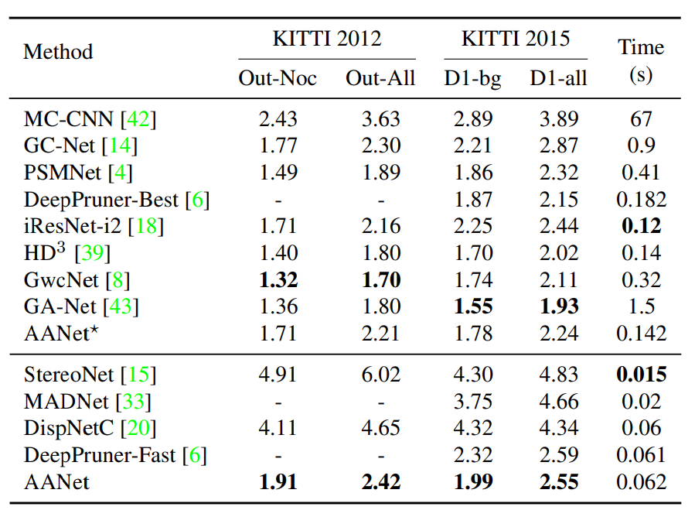
Results on KITTI 2012 and KITTI 2015

Slide 33
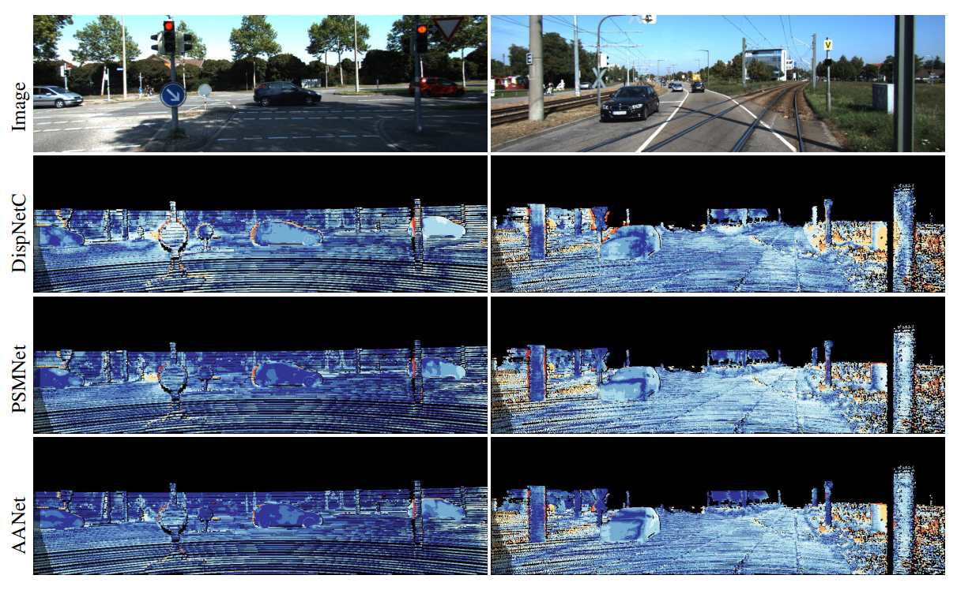
Disparity Prediction Error

Slide 34
Conclusion

Slide 35
Conclusion
Proposed 2 efficient and lightweight modules, ISA and CSA
Replaced 3D convolutions completely by ISA and CSA modules
Speeded up existing top-performance models
Improved the performance of fast stereo models

Slide 36
Proposal

Slide 37
Motivation
After the Covid-19 pandemic, remote healthcare and smart health have become significant concerns for people.
Traditional electrocardiography (ECG) poses challenges
Cumbersome wearable devices
The need for trained professionals
Expensive equipment
Making it less suitable for remote healthcare.

Slide 38
Motivation
In this proposal, we suggest utilizing photoplethysmography (PPG) for ECG reconstruction to address these drawbacks.
Simplicity in wearability
Eliminate the need for specialized personnel
Reduce equipment costs

Slide 39
Dataset
BIDMC open dataset
Subjects : 53
FPS: 125Hz
Record data length: Each subjects about 5-8 min
Contains: PPG、ECG、SpO2、HR、RR

Slide 40
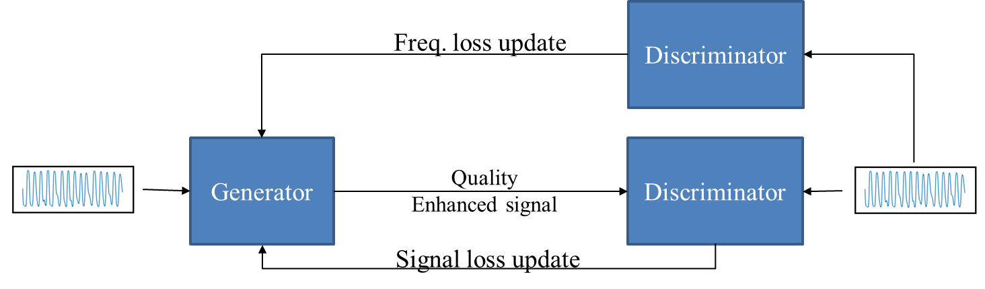
Structure
Using GAN with 2 discriminator
PPG
ECG Gt.

Slide 41
Evaluation
RMSE
RR interval
Pearson correlation coefficient

Slide 42
Reference
Q. Zhu, X. Tian, C. -W. Wong and M. Wu, "ECG Reconstruction via PPG: A Pilot Study," 2019 IEEE EMBS International Conference on Biomedical & Health Informatics (BHI), Chicago, IL, USA, 2019, pp. 1-4, doi: 10.1109/BHI.2019.8834612
H. -Y. Chiu, H. -H. Shuai and P. C. . -P. Chao, "Reconstructing QRS Complex From PPG by Transformed Attentional Neural Networks," in IEEE Sensors Journal, vol. 20, no. 20, pp. 12374-12383, 15 Oct.15, 2020, doi: 10.1109/JSEN.2020.3000344.
E. Lan, "Performer: A Novel PPG-to-ECG Reconstruction Transformer for a Digital Biomarker of Cardiovascular Disease Detection," 2023 IEEE/CVF Winter Conference on Applications of Computer Vision (WACV), Waikoloa, HI, USA, 2023, pp. 1990-1998, doi: 10.1109/WACV56688.2023.00203.

